Slide 1

Tribhuvan University Institute Of Engineering Kathmandu Engineering College Kalimati, Kathmandu
Smart Gloves Using Flex Sensors
Supervised By: Suramya Sharma Dahal Sir
Submitted By:
Bipin Godar (75005)
Niraj Kushwaha (75014)
Date: 2079/02/13

Slide 2
Contents
Introduction
Objectives
Problem Statement
Applications
Methodology
Gantt Chart
Expected Output

Slide 3
Introduction
This project is a tool for the dumb and deaf to communicate.
It converts sign language into audio that can be heard.
It uses machine learning for fast and accurate expressions.

Slide 4
Objectives
To develop a sensor embedded glove that converts sign language into audio.
Help the disabled to communicate.

Slide 5
Problem Statement
Dumb people have trouble communicating.
Accidents can cause speaking difficulties.

Slide 6
Applications
For dumb and deaf people to communicate.
In hospitals for injured people.
Input device for gaming.

Slide 7
Methodology
Hardware Assembling
Dataset Preparation
System Block Diagram
Flowchart

Slide 8
Hardware Assembling
Configure MPU6050 with accelerometer and gyroscope.
Interface flex sensor and MPU6050 to Arduino Mega 2560.
Connect the Arduino Mega 2560 to laptop to send data.

Slide 9
Dataset preparation
Receive data from Arduino Mega 2560 and write to file.
Classify data and convert the file to csv file format.
Use Random forest classifier in python to train the model.

Slide 10
System Block Diagram

Slide 11
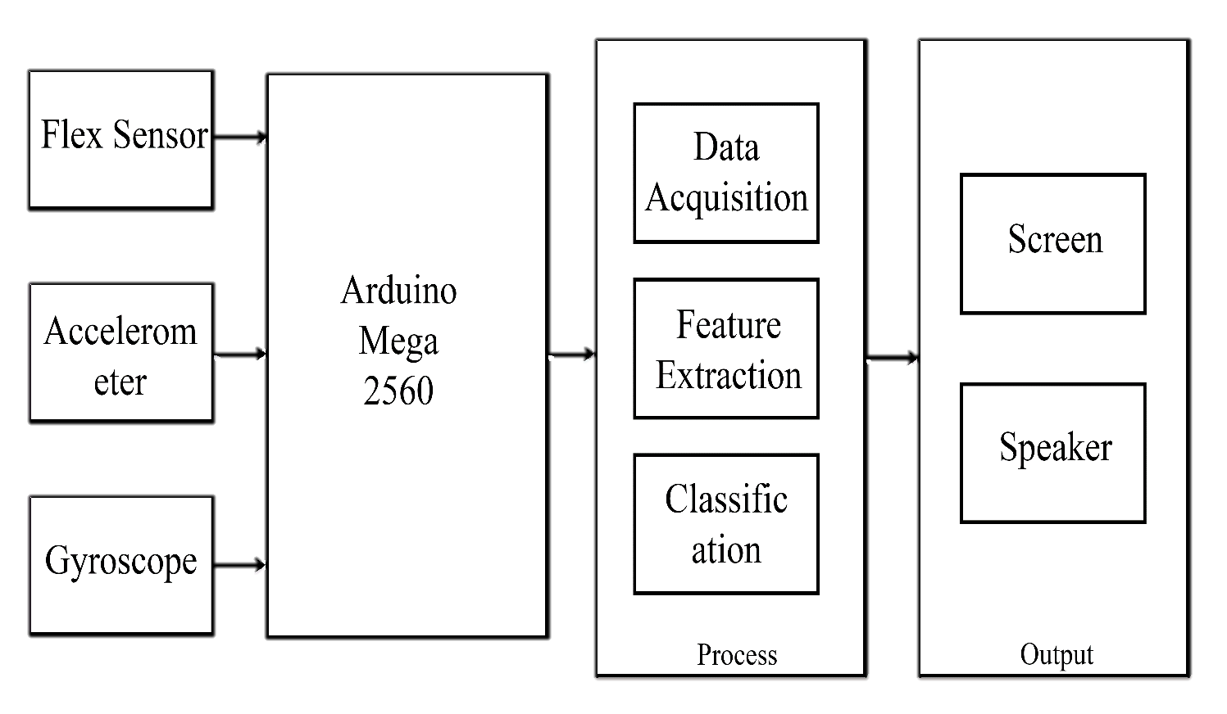

Slide 12
Flowchart for Dataset preparation

Slide 13
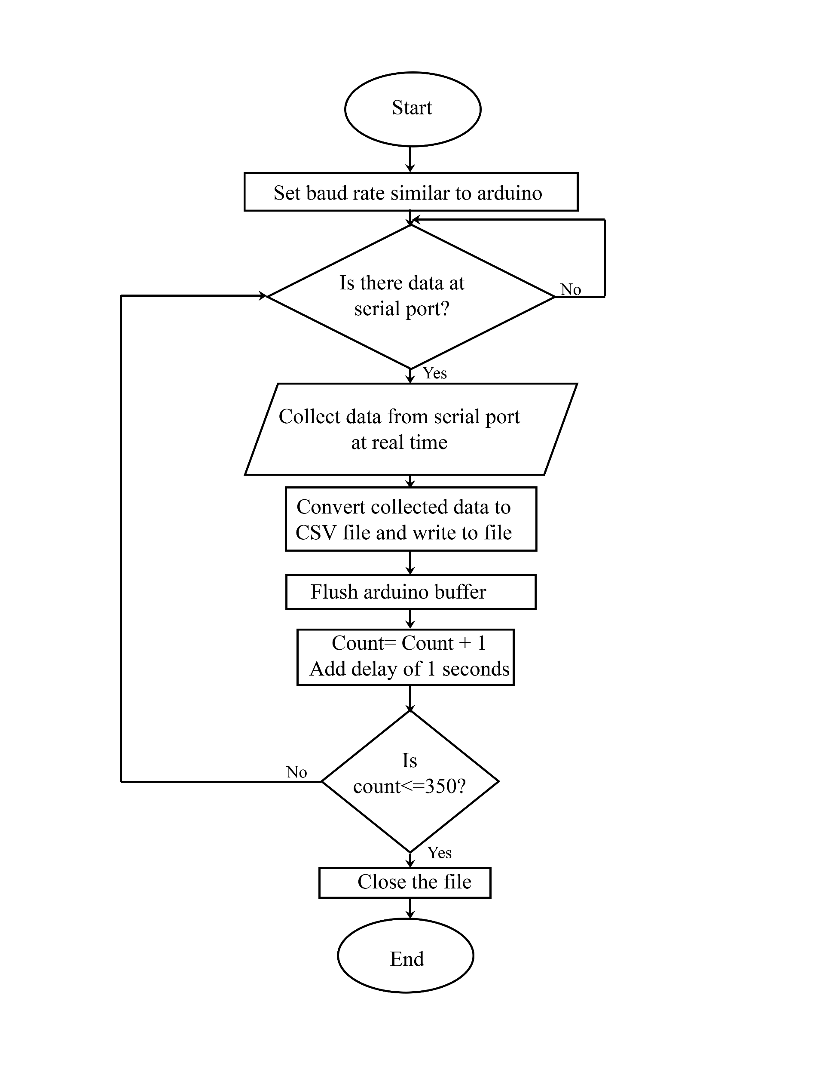

Slide 14
Flowchart for real time application

Slide 15
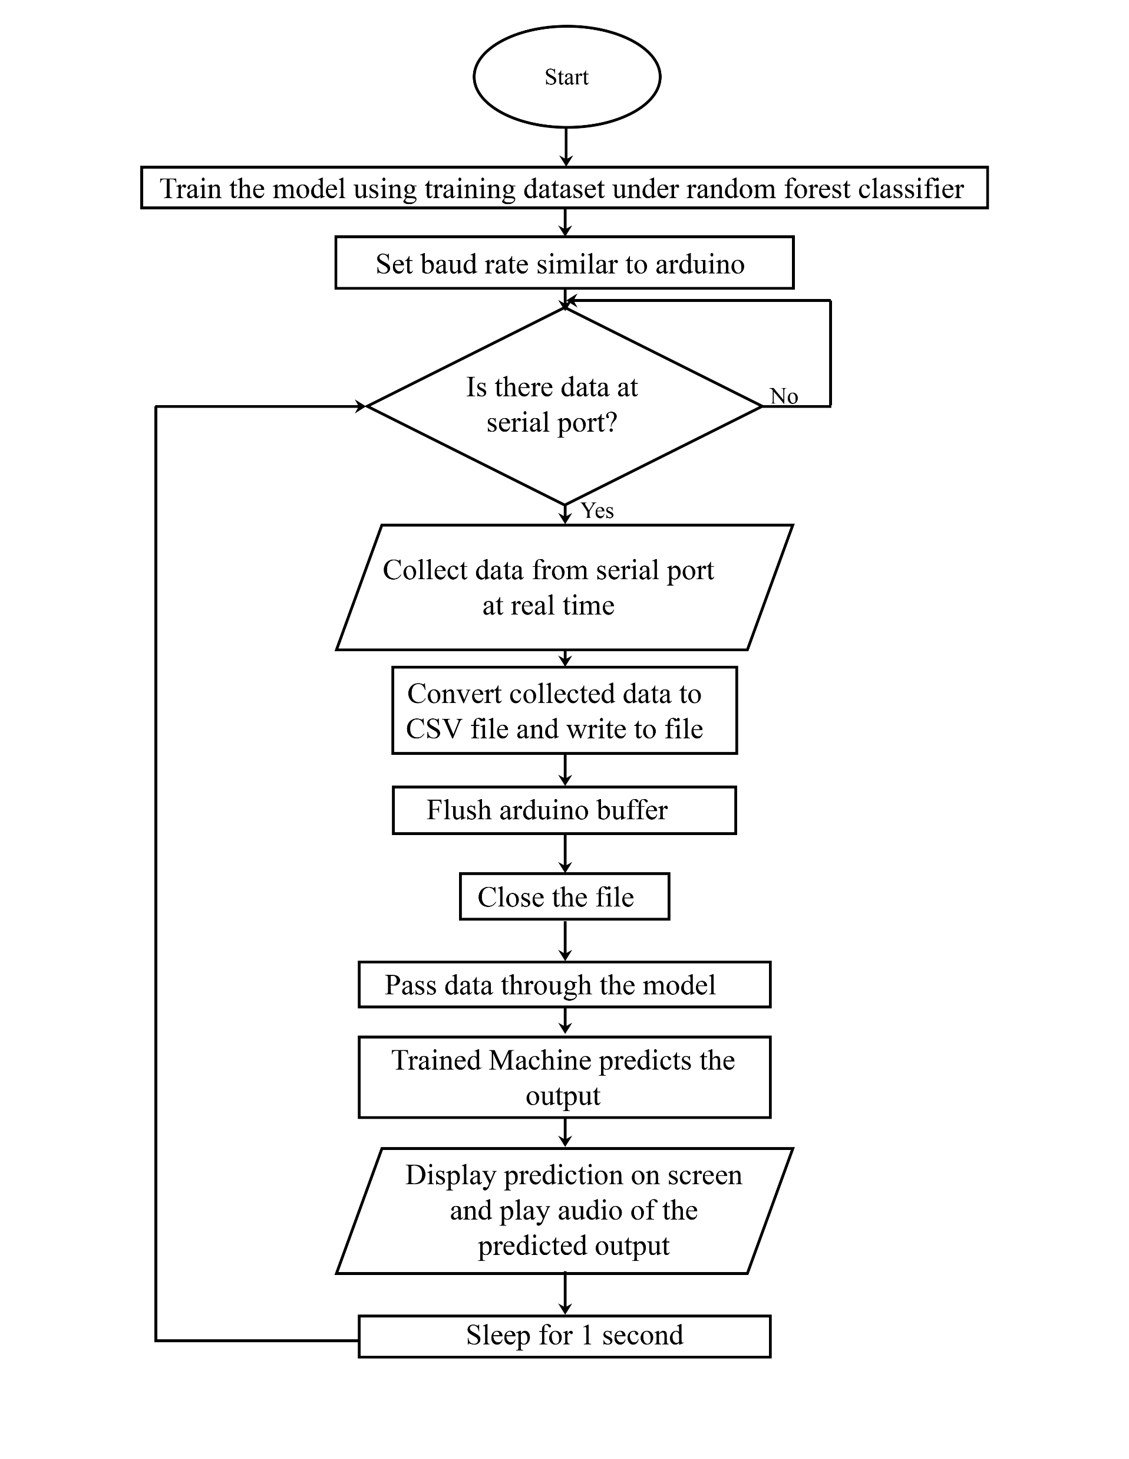

Slide 16
Work Progress
Research Works
Hardware Works
Software Works

Slide 17
Research Works

Slide 18
Why Random Forest classifier?
Neural Networks can not be used as no threshold or bias factors are required.
Regression models requires correlation between datasets.
Support vector machine is best suited for two class problems.
K-Nearest Neighbor assumes similar data to be near each other.
Naïve Bayes takes a probabilistic approach but we need accuracy.
In all, Random Forest is best.

Slide 19
Hardware Works

Slide 20
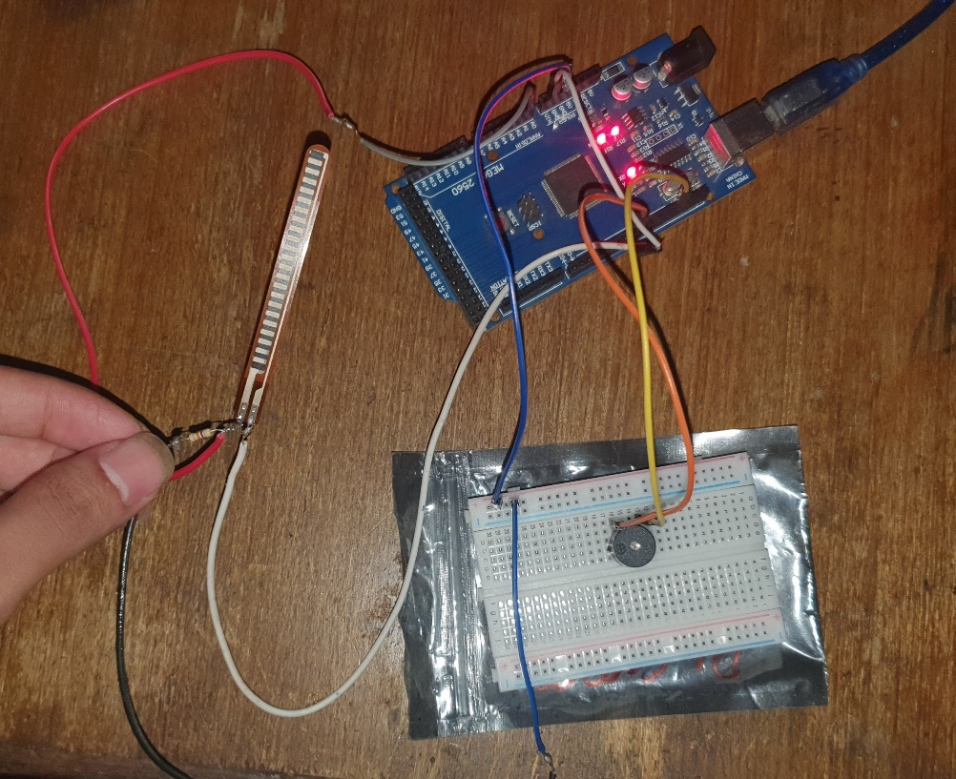
Basic Interfacing

Slide 21
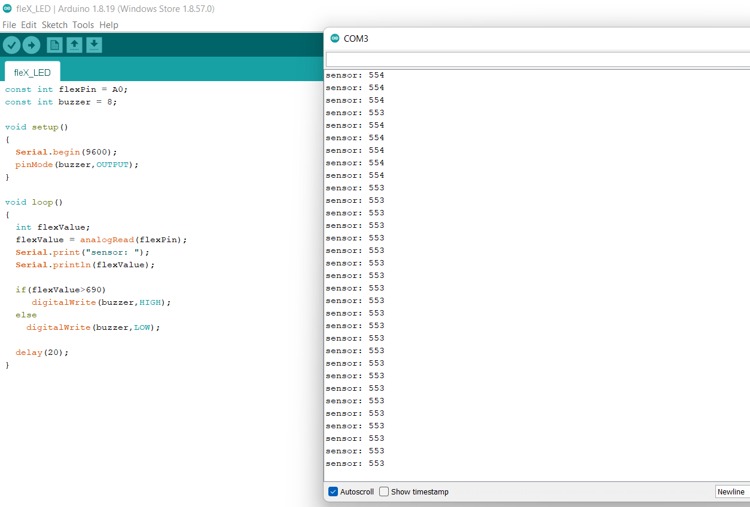
Before Bending
value= 553

Slide 22
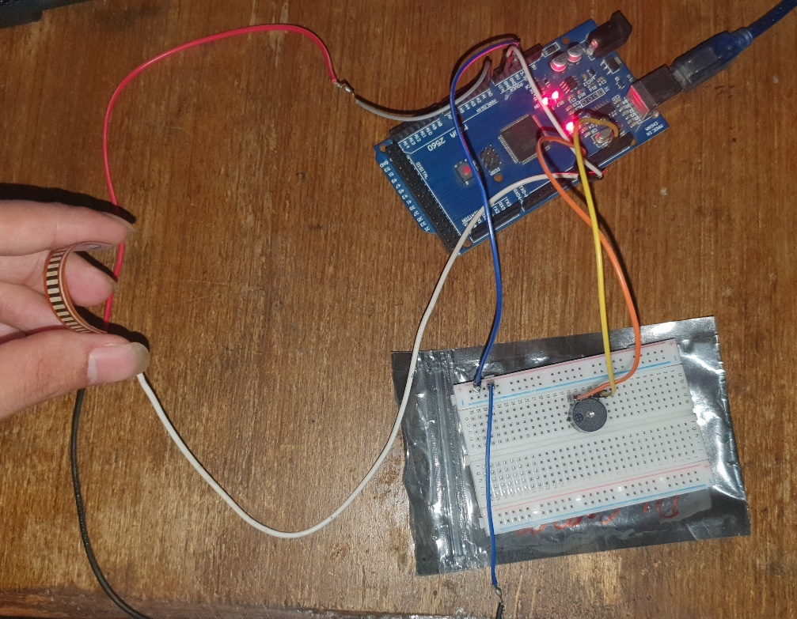
After bending the analog values change as follows.

Slide 23

After Bending
value= 811

Slide 24
Software Works

Slide 25
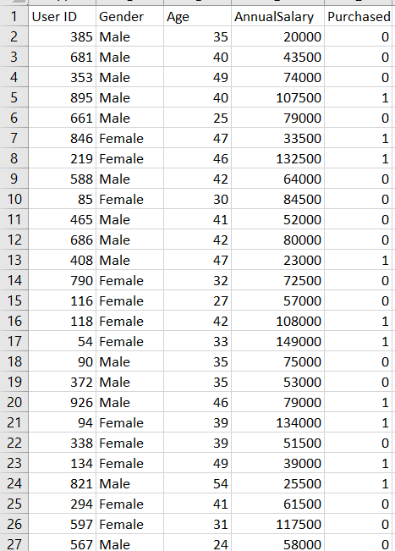
Random Forest Implementation
If a person is likely to purchase a car,
Output= 1
Else,
Output= 0

Slide 26
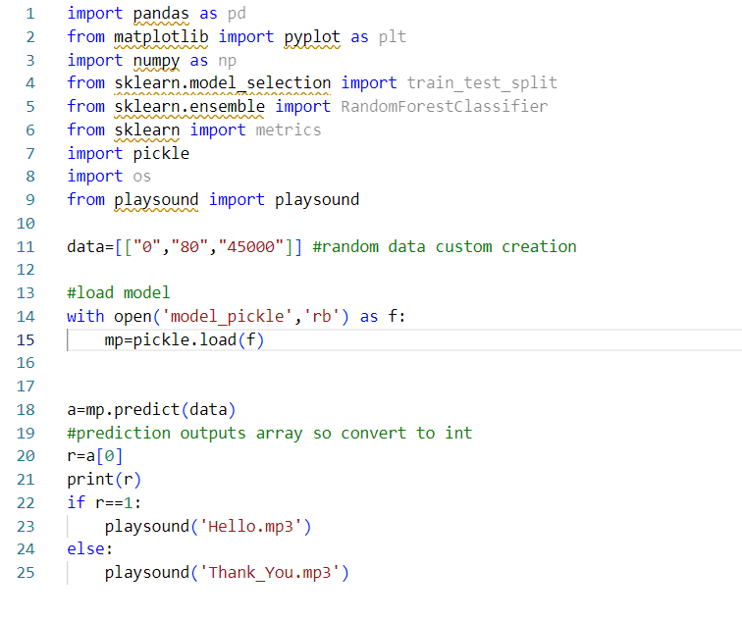

Slide 27
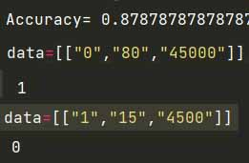

Slide 28
Remaining Works
Data collection and Parsing
Writing Data into excel file
Hardware assembling
Code based on real data model
Research and adjustment as required
Testing and Output Processing

Slide 29
Gantt Chart

Slide 30
List Of Components
Arduino Mega 2560
Flex Sensors
MPU-6050
Bluetooth Module
LCD
I2C Module

Slide 31
THANK YOU

